Slide 1

Federated Learning
Privacy by Design for Machine Learning

Slide 2
Federated Learning What is federated learning?
Federated learning is a machine learning technique that collaboratively trains an algorithm across multiple decentralized edge devices (desktops, mobiles, tablets, IOT devices, etc.) or servers (data silos) holding local data samples, without the need for sharing the data or centrally aggregating them.
This approach contrasts with classical Centralized ML techniques where all the datasets residing on edge devices are uploaded to one central server. Federated Learning also differs from Distributed ML, where the expectation is that the local datasets will be identically distributed with constant availability of the nodes.
Model
Model
Revised Weights
Central Server
Central Server
Aggregation
ML Training
Trained Models
Big Data
Model Weights
Train
Train
Train
Data
Data
Data
Data
Data
Data
Data
Edge Devices
Traditional ML Approach
Federated ML Approach

Slide 3
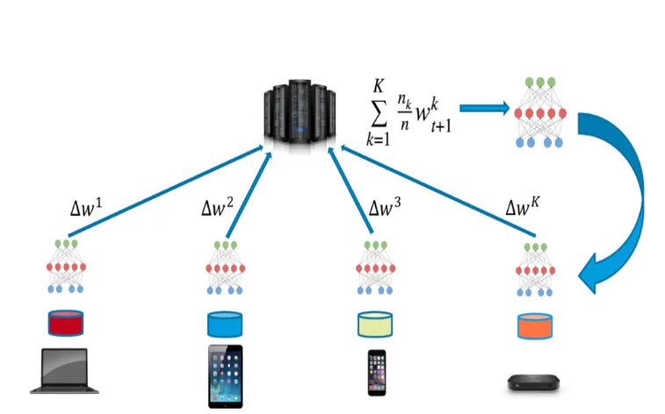
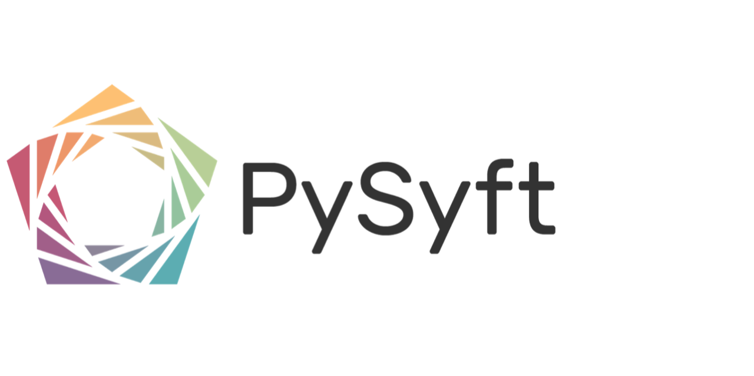


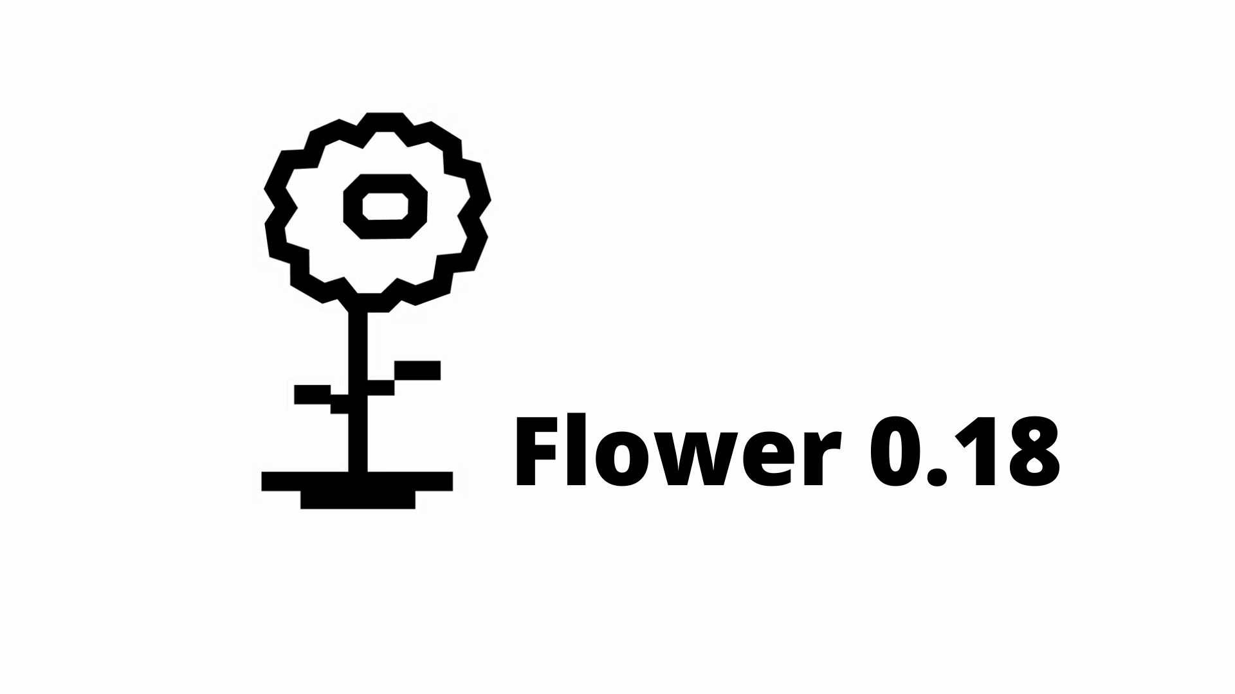
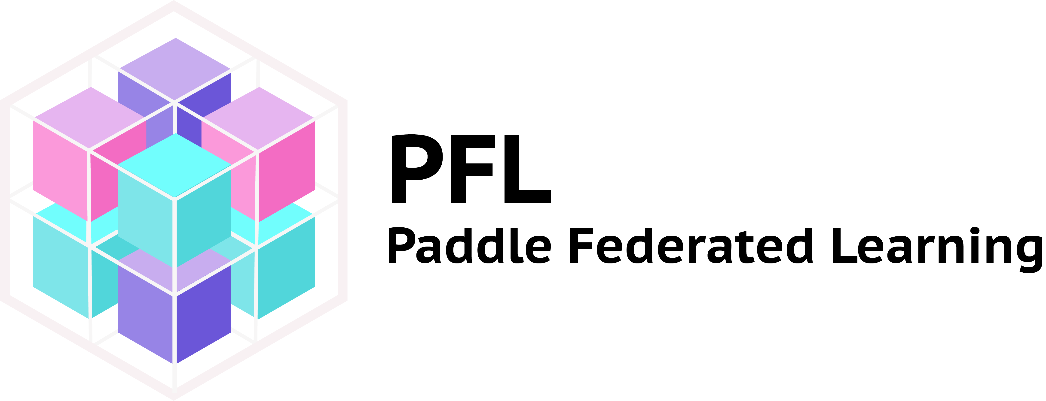
Federated Learning Steps involved in Federated Learning & Privacy
A model instance is running in each of the device.
Once the training is complete on the local data, the device connects to the server and the model weights/parameters are sent to the central server.
The central server aggregates the weight parameters and sends the updated weights back to each device. (Thus, ensuring that data never leaves the device, and we get the benefit of training on the data from all the devices.)
Once the devices receive the updated parameters, they can now use the updated model parameters for their individual tasks.
Python Libraries to Implement Federated Learning

Slide 4
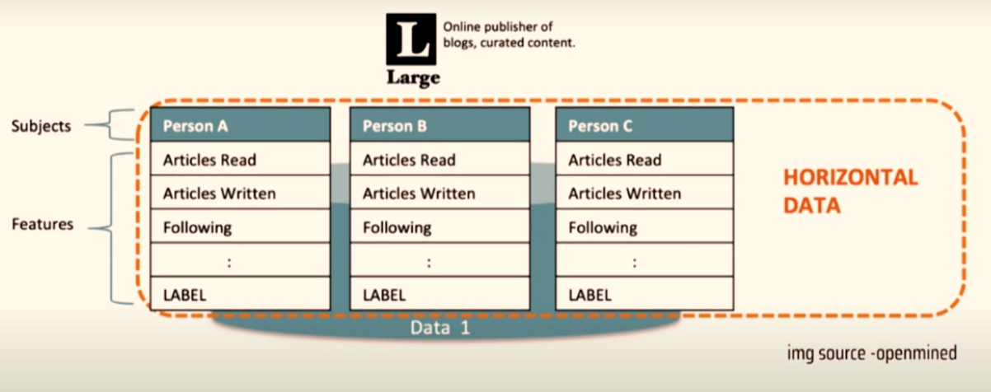
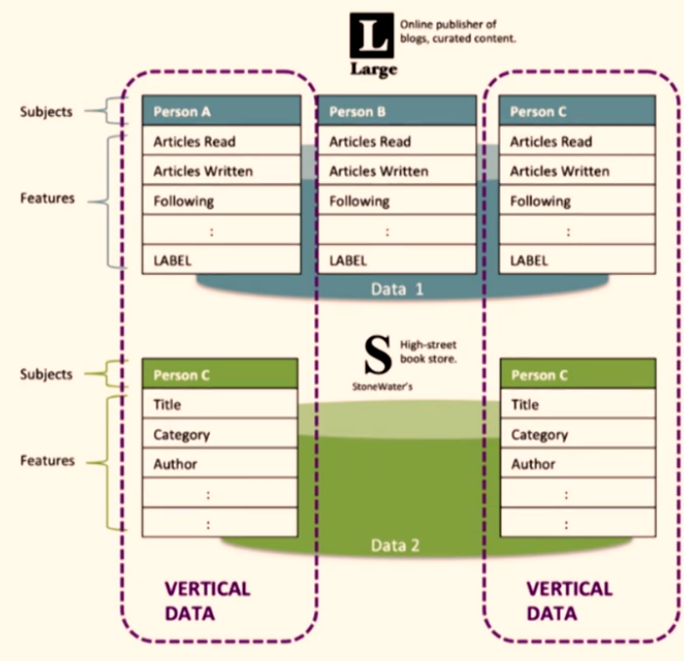
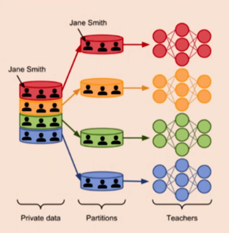
Federated Learning FL Systems
Data Partitioning
Machine Learning Models
Privacy Mechanisms
Scale of Federation
Architecture
Horizontal
Vertical
Differential
Privacy
Cryptographic Methods
Differential Privacy inserts random data to the original data set at collection stage to mask individual data points before the are further anonymised on a server.
Cross Silo
Cross Device

Slide 5
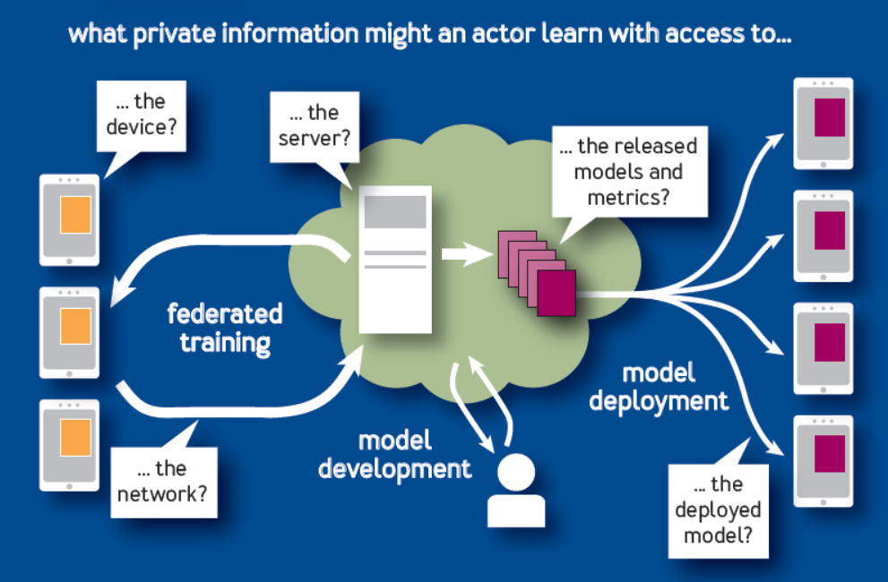
Federated Learning Flow of Information

Slide 6
Federated Learning Limitations & Challenges
The client devices run multiple steps of Stochastic Gradient Descent (SGD) on their local data to compute an update.
Server computes an overall update using a simple weighted average of the client updates.
There exist ways in which local model updates can be reverse-engineered by an eavesdropper or at the aggregating server, via Model-Inversion or Membership-Inference attacks. Since Federated Learning deals with individual model updates sent by end-users, inversion of the difference between the original model and the updated model, can potentially reveal a lot of sensitive information.
Federated Learning doesn’t guarantee the resultant aggregated model will be “better” than the individual models.
Federated Learning, by design, is not impervious to Data Poisoning attacks, where a compromised end-user sends corrupted model updates.
Popular approaches of Federated Learning involve only a fraction of the User Pool for training, therefore utmost care needs to be taken to ensure Fairness is achieved.

Slide 7
Implementation

Slide 8
Federated Learning Implementation of Federated Learning using Flower
We will build a simple pytorch based neural network model to read images and classify them.
We will first train the model on the local data in client. Let's start with 3 devices, so we have 3 locally running models in 3 separate devices.
Once our model is trained and we have our model parameters, we try to connect with the server.
The server then either accepts or rejects the invitation to connect based on some policy. Here we will simply use a First Come First Serve policy.
Central Server Monitored
by Data Scientists
Server
Updated Model Weights
Model Weights
Client
Client
Client
Edge Devices/Local Machines where Data Stored
If the connection goes through, the client sends the model parameters to the server.
The server waits for all 3 model parameters and then aggregates them thus making use of all the data in all the models.
This can happen for as many epochs as we want to train the data.
Then the server sends the updates weight parameters back to the clients.
The client will now use the weights for image classification.

Slide 9
Federated Learning Implementation of Federated Learning using Flower
import os
import flwr as fl
import tensorflow as tf
# Make TensorFlow log less verbose
os.environ["TF_CPP_MIN_LOG_LEVEL"] = "3"
# Load model and data (MobileNetV2, CIFAR-10)
model = tf.keras.applications.MobileNetV2((32, 32, 3), classes=10, weights = None)
model.compile("adam", "sparse_categorical_crossentropy", metrics=["accuracy"])
(x_train, y_train), (x_test, y_test) = tf.keras.datasets.cifar10.load_data()
# Define Flower client
class CifarClient(fl.client.NumPyClient):
def get_parameters(self, config):
return model.get_weights()
def fit(self, parameters, config):
model.set_weights(parameters)
model.fit(x_train, y_train, epochs=1, batch_size=32)
return model.get_weights(), len(x_train), {}
def evaluate(self, parameters, config):
model.set_weights(parameters)
loss, accuracy = model.evaluate(x_test, y_test)
return loss, len(x_test), {"accuracy": accuracy}
# Start Flower client
fl.client.start_numpy_client(server_address="127.0.0.1:8080", client=CifarClient())
import flwr as fl
# Start Flower server for three rounds of federated learning
if __name__ == "__main__":
strategy = fl.server.strategy.FedAvg(
fraction_fit=0.1,
min_available_clients=2
)
fl.server.start_server("[::]:8080", config={"num_rounds": 3}, , strategy=strategy)
Client Script
Server Script

Slide 10
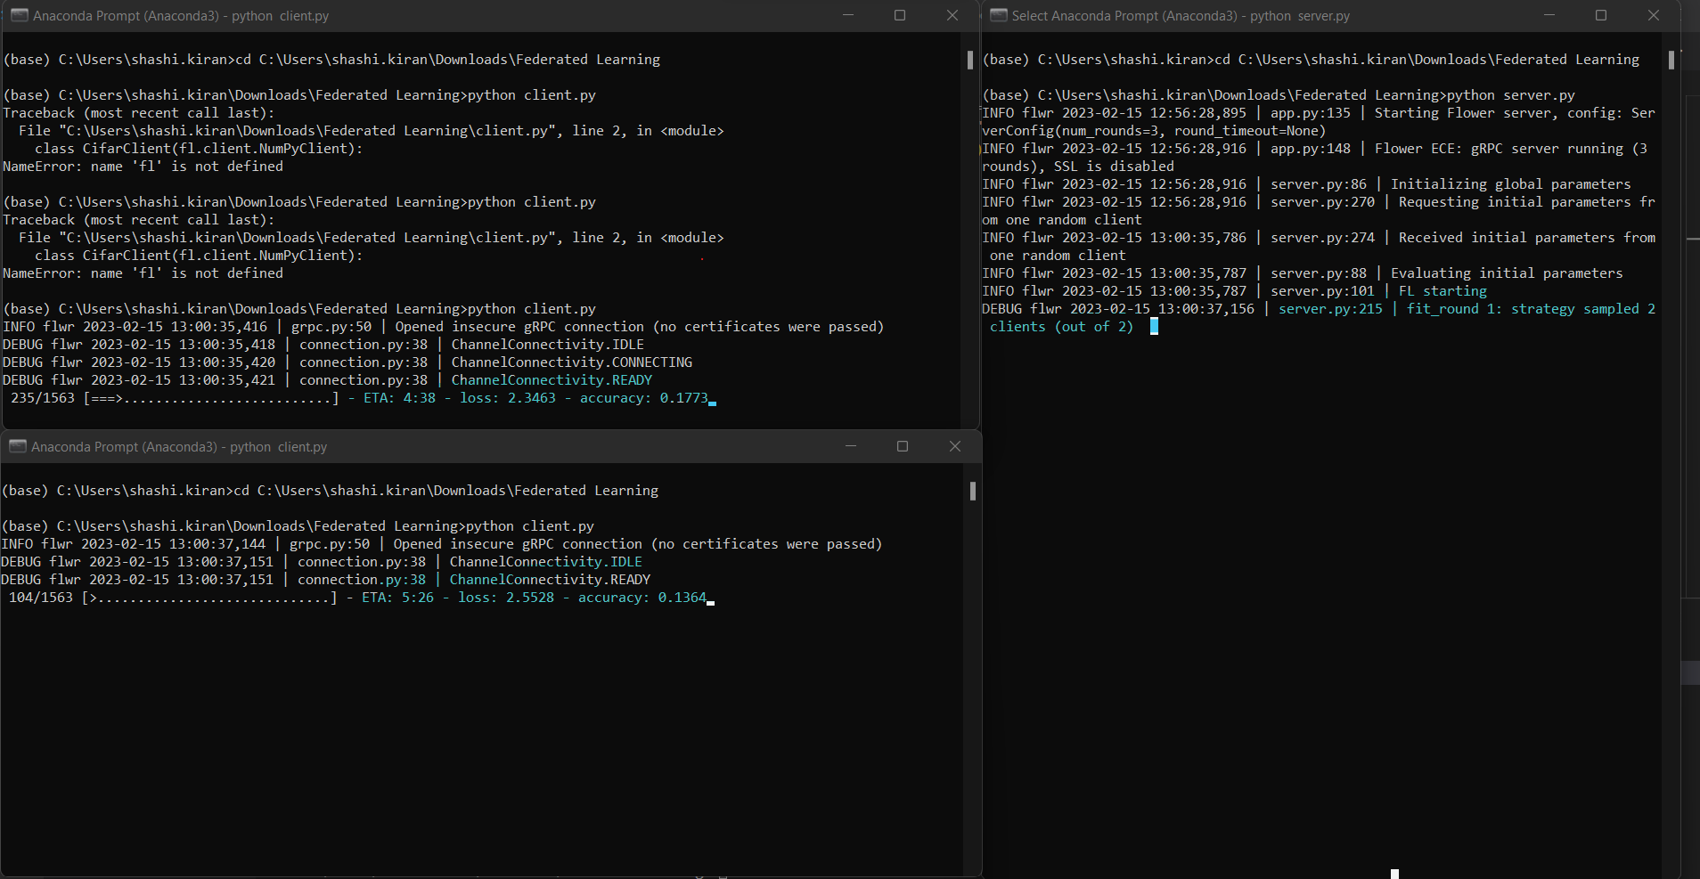
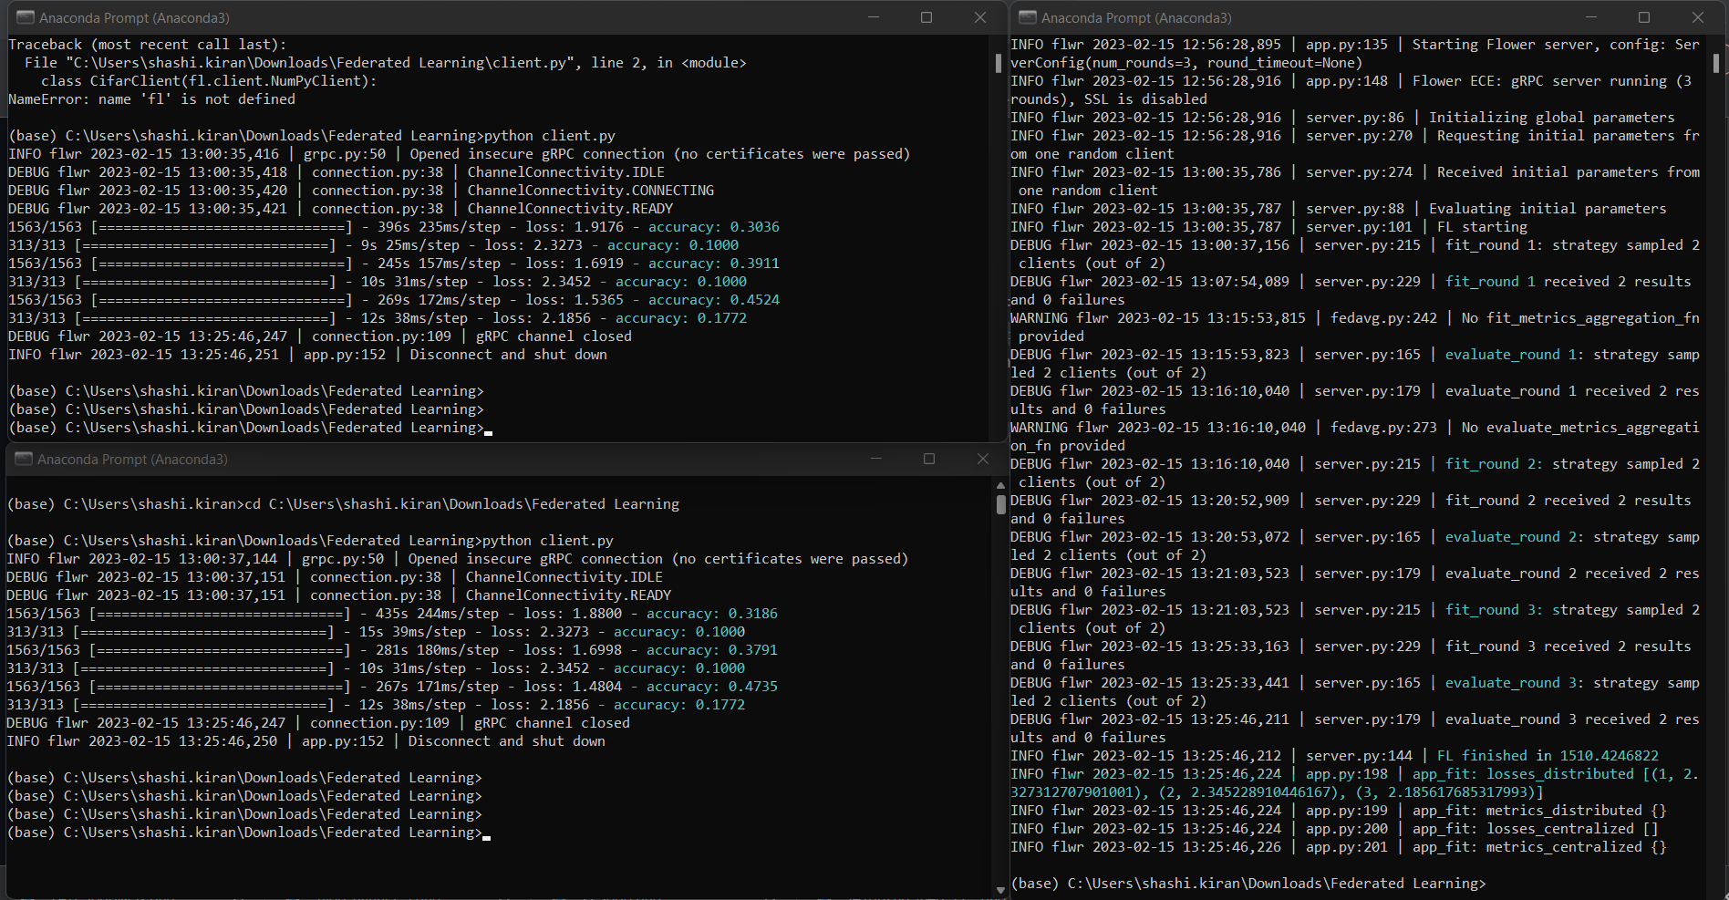
Federated Learning Local System Implementation of Federated Learning using Flower
Server
Client 1
Client 1
Server
Client 2
Client 2
While Client Running
Server Weights updated

Slide 11
Federated Learning Use Cases….

